Slide 1
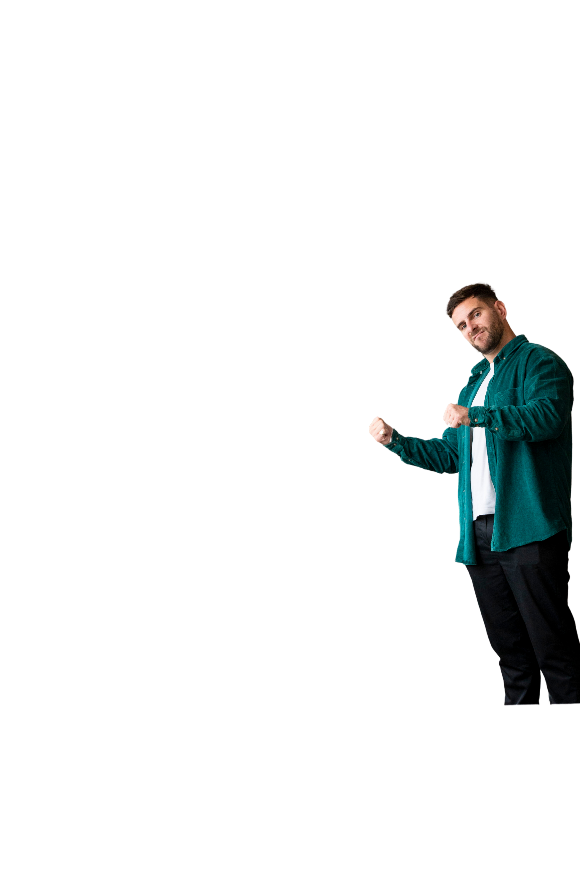

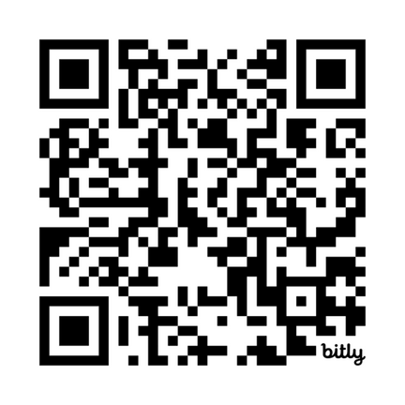


Scan for today’s agenda & info (but keep it to yourself)

Slide 2
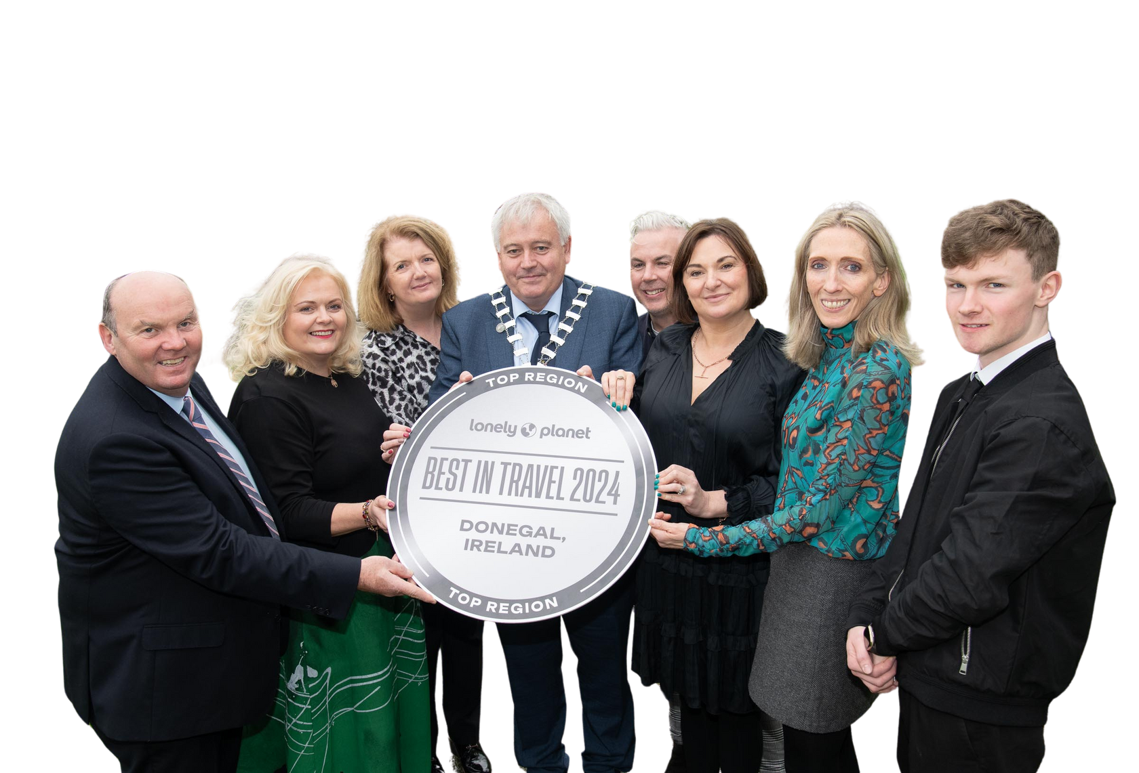
Welcome from the Donegal Tourism team!

Slide 3



Donegal Tourism CLG
For the latest industry updates follow us on our socials

Slide 4
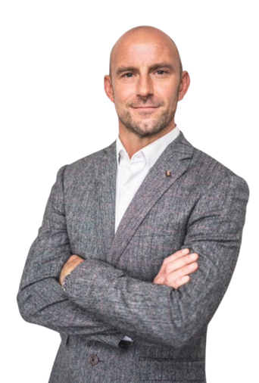
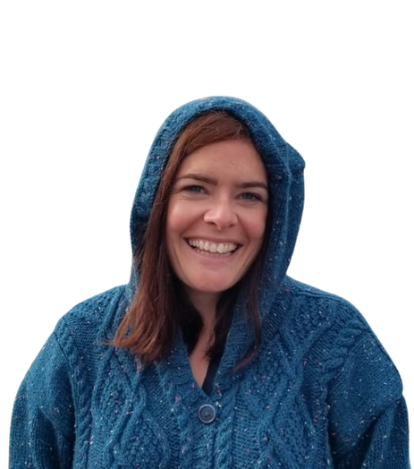
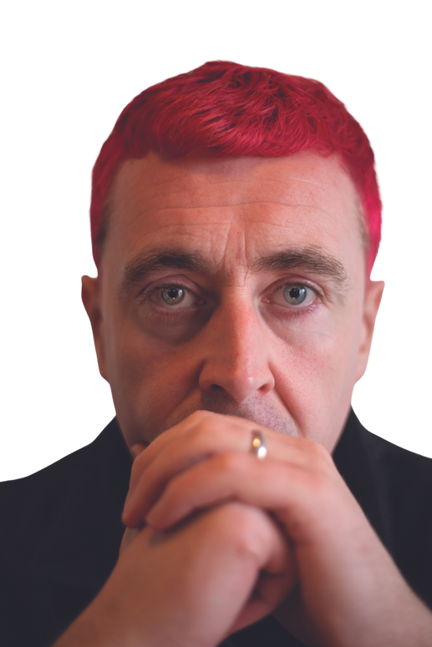
Today’s Speakers
Daniel Browne (MC)
Sea Sessions
Amy Lynch
Lonely Planet
Michael Corcoran
Frankly

Slide 5
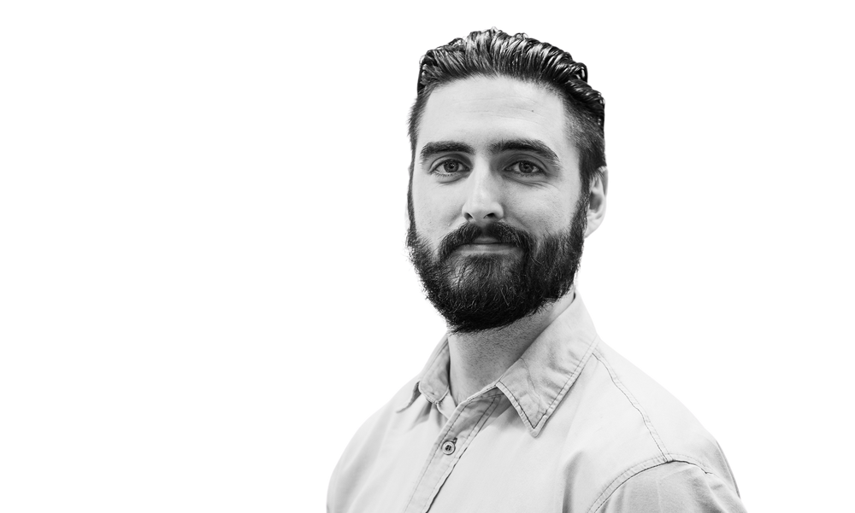
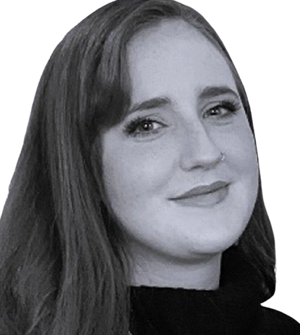
Today’s Speakers
Alan Owens
Failte Ireland
Anita Conefrey
ATU
Use the hashtag
#LoveDonegal

